Slide 1
SXL : TSX.V
Fall 2025

Slide 2

Cautionary Statement
Except for the statements of historical fact contained herein, certain information presented constitutes “forward-looking information” within the meaning of applicable Canadian securities legislation. Forward-looking information includes, but is not limited to, statements regarding: the results and interpretation of exploration activities, including trenching, sampling and drilling; expectations regarding assay results from pending samples; the timing and scope of future exploration programs; the potential for new discoveries on the Jake Lee, Roger Lake, Love Lake Menneval and Goodwin projects; the significance of gold and base metal values obtained from grab, float and drill samples; the planned IP surveys and potential drill programs on the Goodwin property; the receipt of future cash and share payments under existing option or royalty agreements; and the potential future value of SLAM’s NSR royalty interests.
Forward-looking information is based on assumptions that may prove to be incorrect, including assumptions regarding: the reliability of historical and current exploration data; that mineralization encountered in grab samples and drill core is indicative of potential economic quantities; that planned exploration activities will be completed as scheduled; that the Company will continue to have access to capital and to skilled personnel; and that partner companies will meet their obligations under property agreements.
Forward-looking information is subject to known and unknown risks, uncertainties and other factors that may cause actual results or events to differ materially from those expressed or implied in such information. These risks include, but are not limited to: the inherent risks of mineral exploration and development; fluctuations in commodity prices; risks related to title, permits and access; environmental risks; operating risks; delays in obtaining or failure to obtain required approvals; and risks related to joint venture and option counterparties failing to meet obligations.
Readers are cautioned not to place undue reliance on forward-looking information. SLAM disclaims any intention or obligation to update or revise any forward-looking information, whether as a result of new information, future events or otherwise, except as required by applicable securities laws.

Slide 3



Management Team
Mike Taylor, P. Geo
President, CEO and Director
SLAM Exploration Ltd.'s CEO since 1996, led its TSX-V listing and built a precious/base metal portfolio. Veteran of New Brunswick’s mineral exploration industry - discovering the Farley Lake and Maisie gold deposits, and is a former Director of the Prospectors and Developers Association of Canada.
Jimmy Gravel
Vice President and Director
A sales and marketing grad, has since gained geological expertise in Canadian mining. He leads Florence Creek Inc. (Yukon), co-founded 21Alpha Resources Inc. (Nova Scotia), and heads NBGold Inc. (New Brunswick). As former CEO of Genius Properties, he led its shift to Cerro De Pasco Resources, now worth over $100M.
Jacques Turcotte
Director
Education in civil engineering, IT management, and financial planning, bringing 35 years of real estate and construction expertise and over 15 years of experience being an investor and business development advisor for Canadian mining exploration companies.

Slide 4
Company Overview
Shareholder Breakdown
Institutional
~1%
Share Price | $0.12
Shares Outstanding | 130.6M
Base Market Cap | $15.68M
Warrants Issued | 28.4M
Stock Options Issued | 7.0M
Fully Diluted Shares Outstanding | 166M
Insider 58%
Retail 41%
*as of November 4, 2025

Slide 5
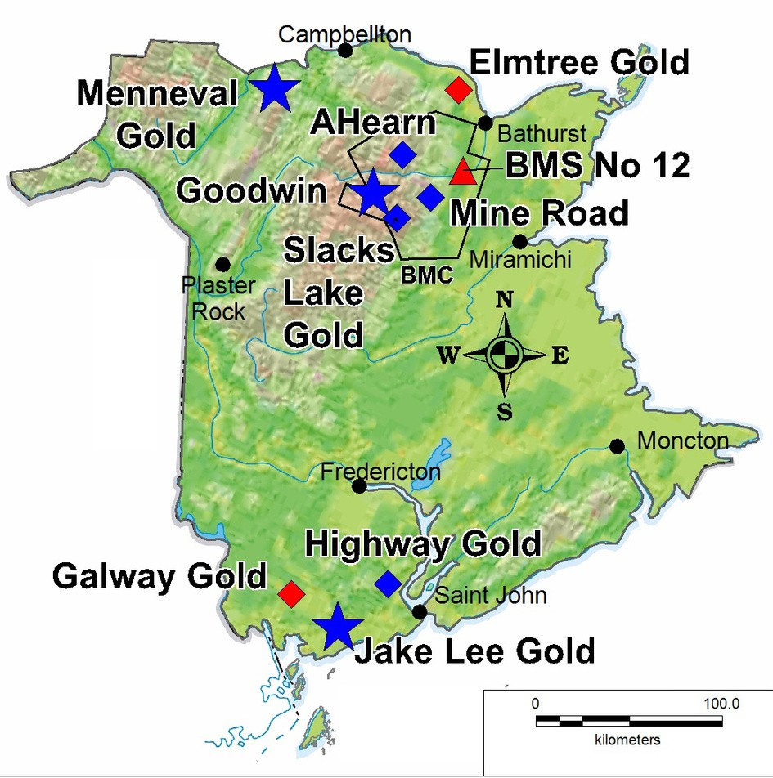
New Brunswick, Canada
Located in New Brunswick
Goodwin Copper Nickel Cobalt
Jake Lee - Love Lake Gold Menneval Gold
Mine Road Copper Zinc Slacks Lake Gold
“IP and drilling results demonstrate that the Goodwin copper-nickel-cobalt project has the potential to contribute meaningfully to Canada’s critical elements portfolio in the mineral-rich province of New Brunswick. Copper, nickel and cobalt are key metals in Canada’s economic strategy for critical elements, and we expect Goodwin to play a significant role”
-Mike Taylor, 2025

Slide 6
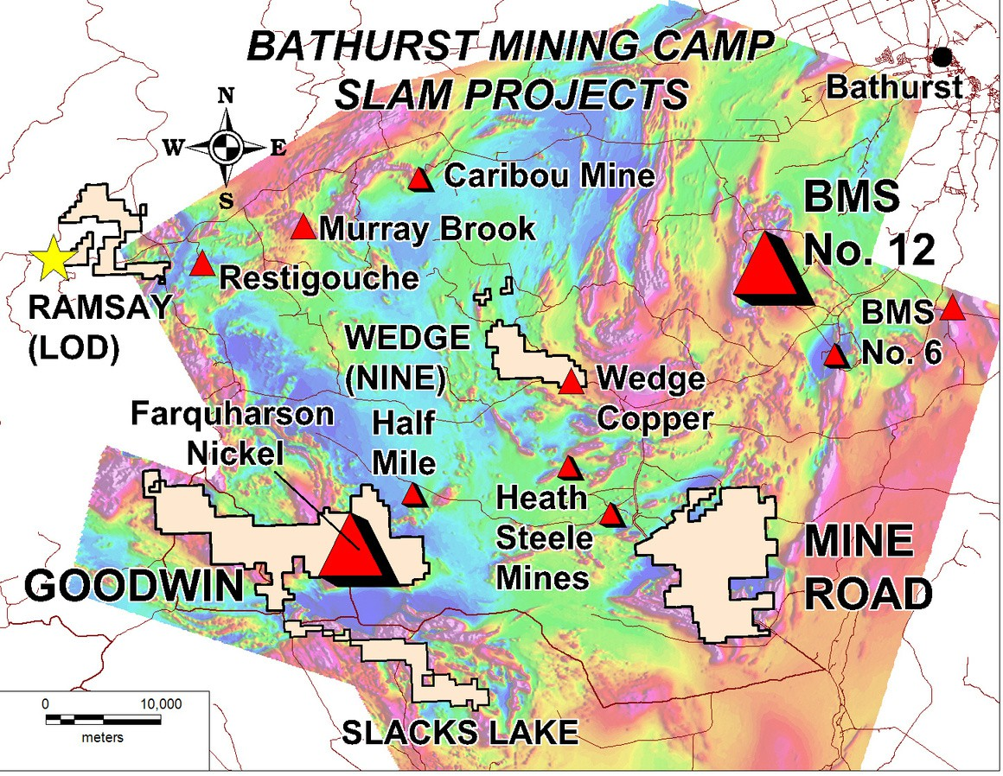
SLAM Exploring A World Class Mining District
Bathurst Mining Camp (BMC) Slam Projects
Goodwin Copper-Nickel-Cobalt Mine Road Copper-Zinc
Slacks Lake Gold
BMC Mineral Resources
Total Resource Estimate at 496.9 Mt
BMS No. 12 Deposit
136M tonnes mined over 50 years
at a grade of 8.74% Zn, 102.2 g/t Ag, 3.44% Pb
Heath Steele Mines 21M tonnes mined at 4.98% Zn, 0.36% Pb, 0.54% Cu, and 69.66 g/t Ag

Slide 7
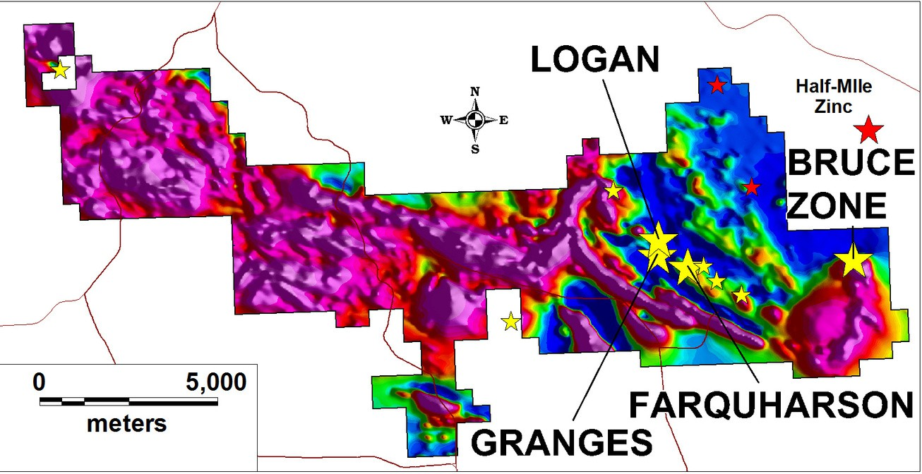
The Goodwin Project - 12,000 Hectares
Copper-Nickel-Cobalt
Significant Cu-Ni-Co Drill Intercepts
Granges Zone:
64.90m grading 2.19% CuEq*
Farquharson Zone:
60.60m grading 1.17% CuEq**
100% Owned by SLAM Exploration
Mining-Friendly Jurisdiction Year Round Road Access Drill Ready
*Copper Equivalent based on SLAM News Release August 7, 2024
**Copper Equivalent based on SLAM News Release August 12, 2024

Slide 8
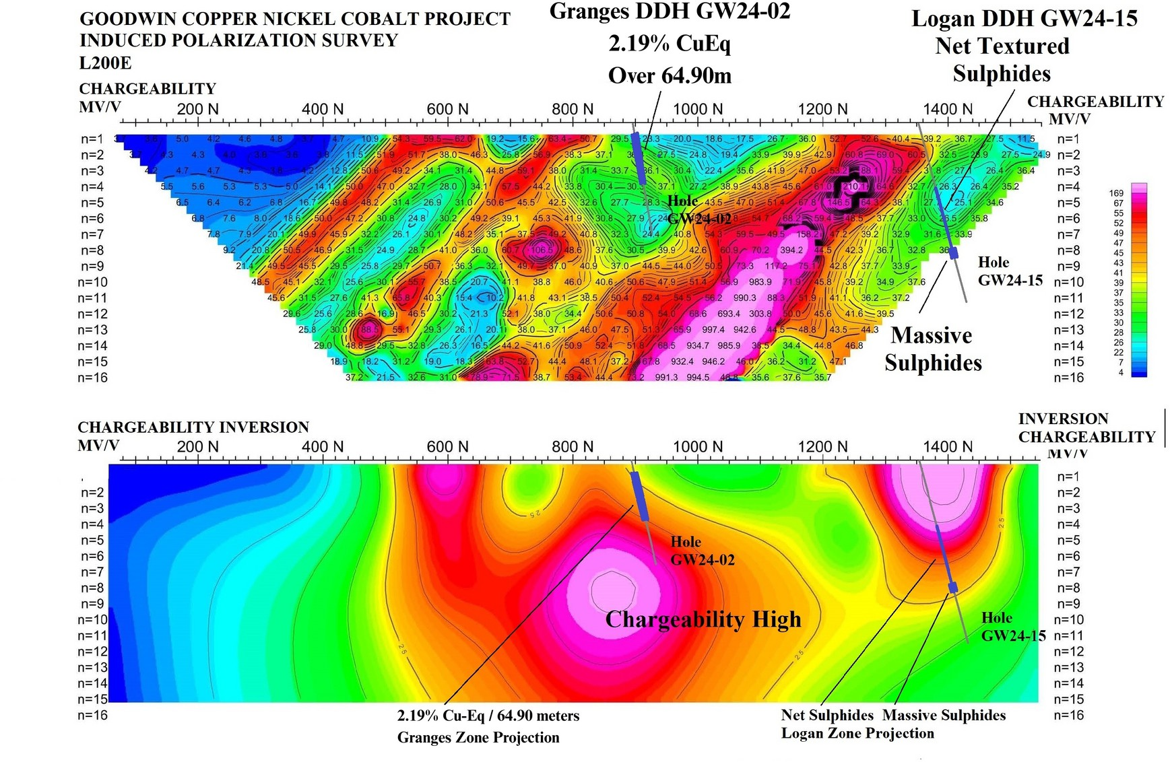
Goodwin Induced Polarization (IP) Survey

Slide 9
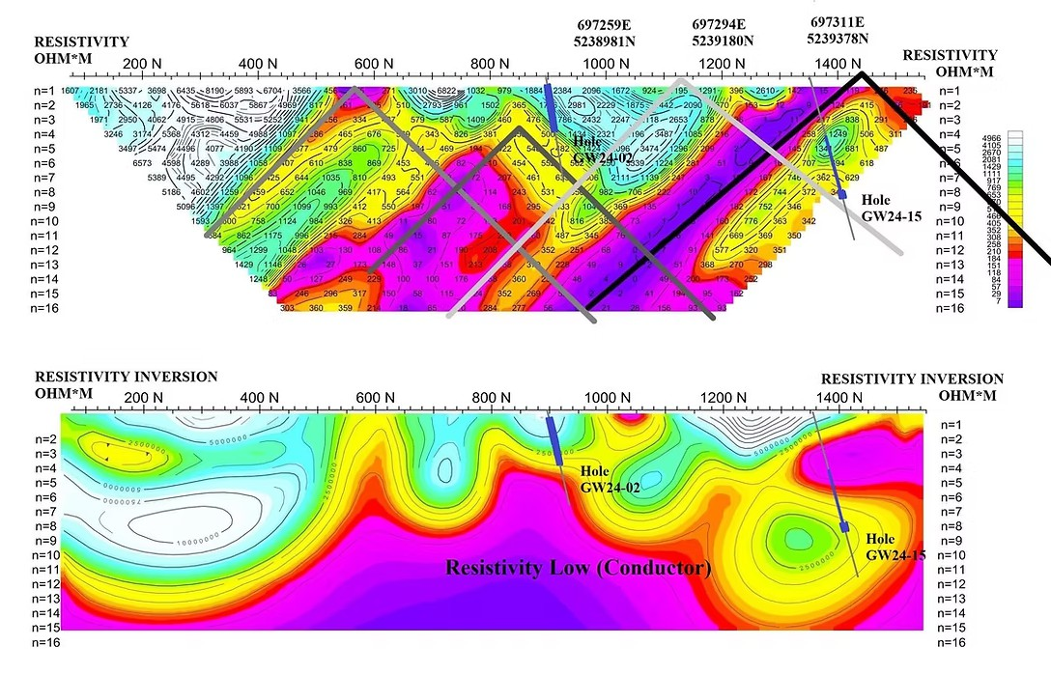
Goodwin Induced Polarization (IP) Survey

Slide 10
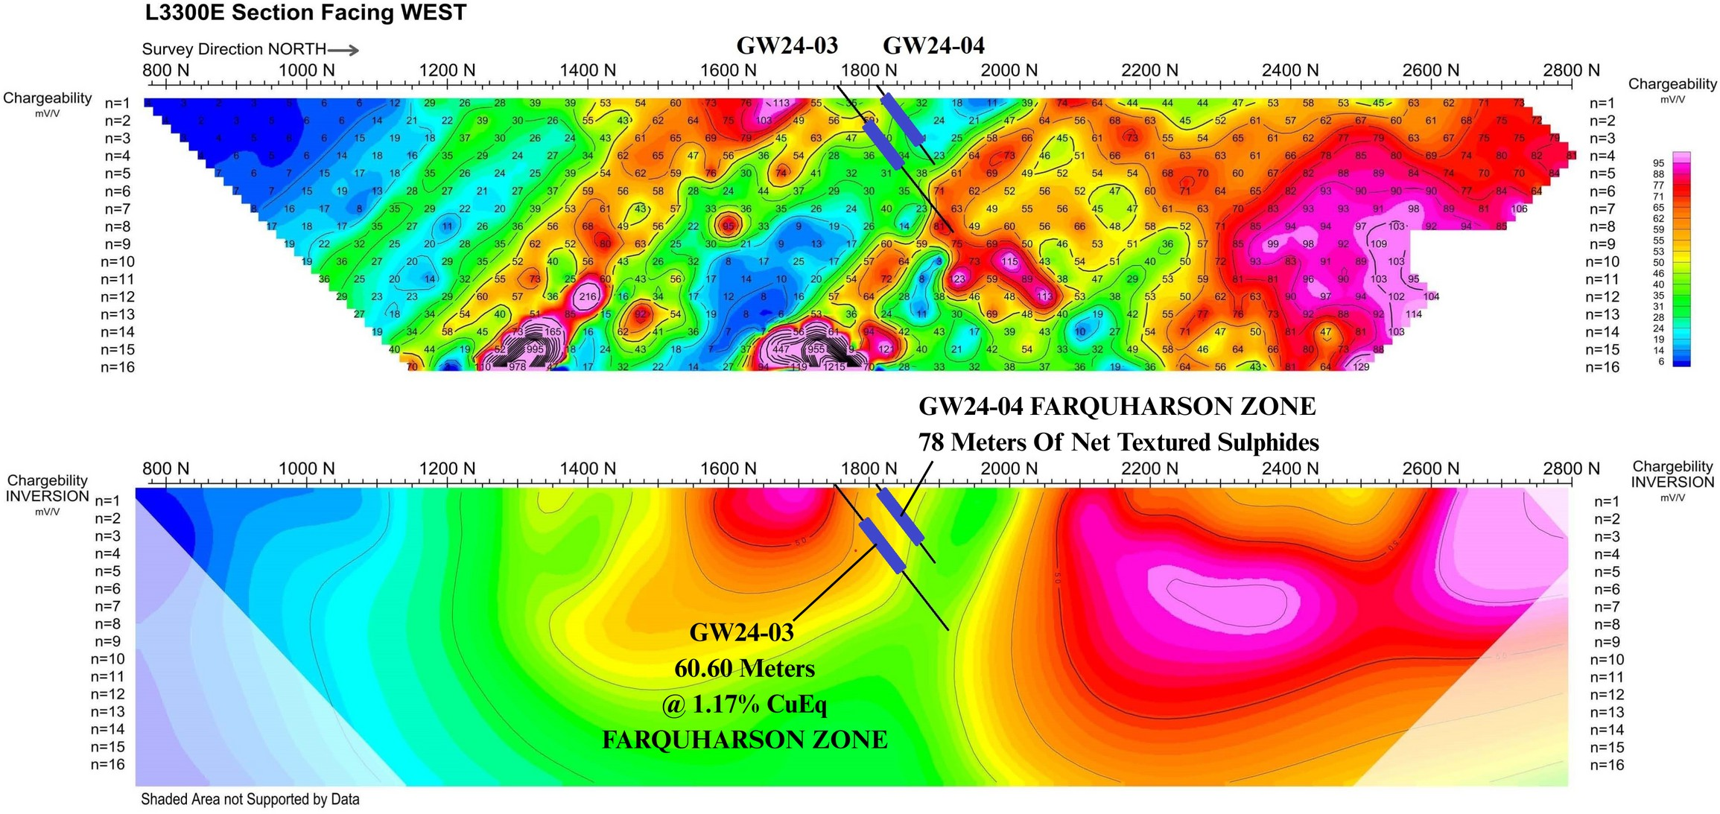
Goodwin Induced Polarization (IP) Survey

Slide 11
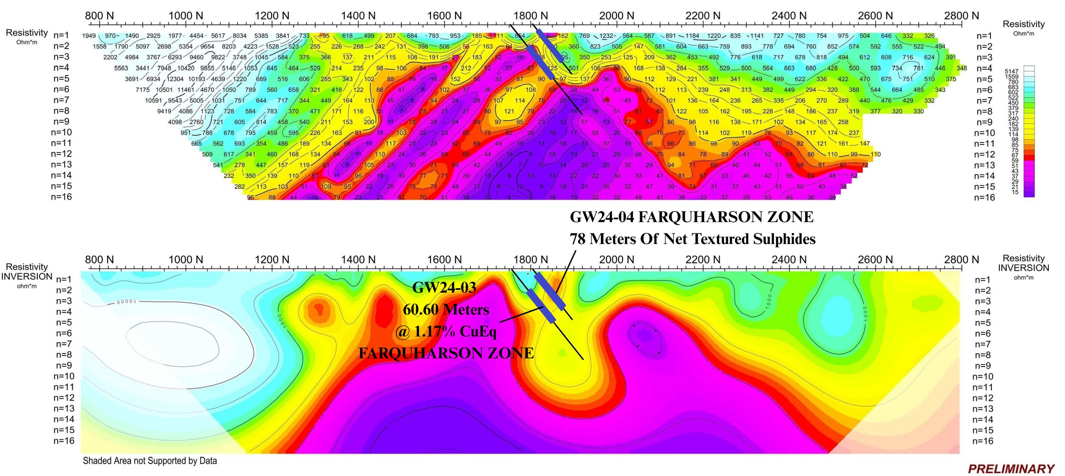
Goodwin Induced Polarization (IP) Survey

Slide 12
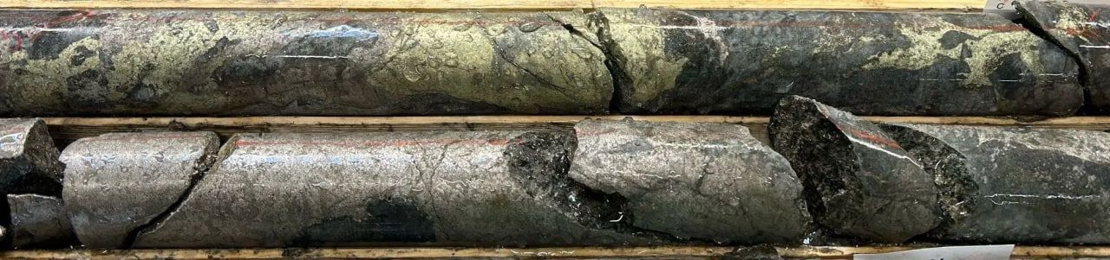
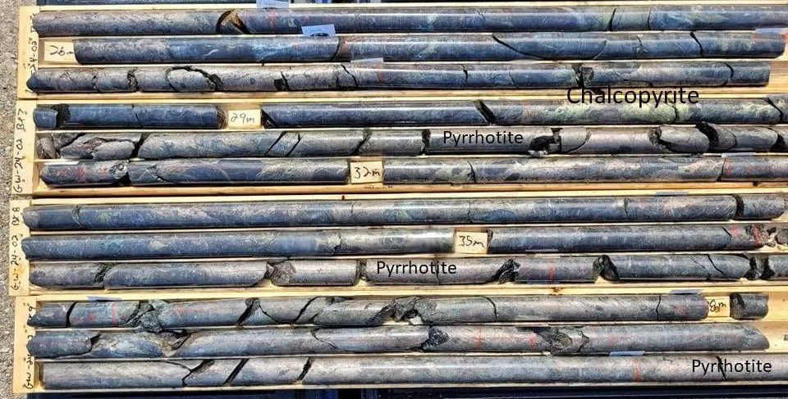
Goodwin Copper-Nickel
GW24-02
23.60m - 54.80m
31.20m
Grading 3.84% CuEq*
*SLAM News Release August 7, 2024

Slide 13
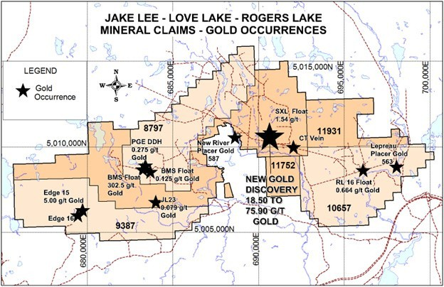
The Jake Lee Love Lake Gold Project
High Grade Gold Discoveries
Slam discovered a new gold vein with 8 grab
samples ranging from 7.42 grams per tonne (g/t) to 94.80 g/t gold from a trench reported July 8,2025. This road-accessible new gold discovery on Slam’s wholly-owned Jake lee claims is located 35 km west of Saint John, New Brunswick
Slam has optioned the adjacent Love Lake claim where the Company intends to find the source of gold-bearing quartz float grading 302.5 g/t gold discovered by previous workers.

Slide 14
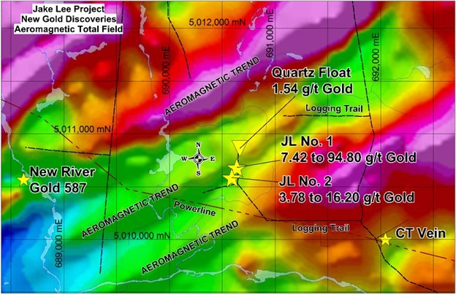
Jake Lee - New Gold Discoveries
New Gold Discoveries
JL No. 1
Assays from 7.42 g/t to 94.80 g/t gold reported July 8, 2025
JL No. 2
New discovery 100 meters south of JL No. 1 with assays of 3.78 and 16.20 g/t
Au reported August 28, 2025.

Slide 15
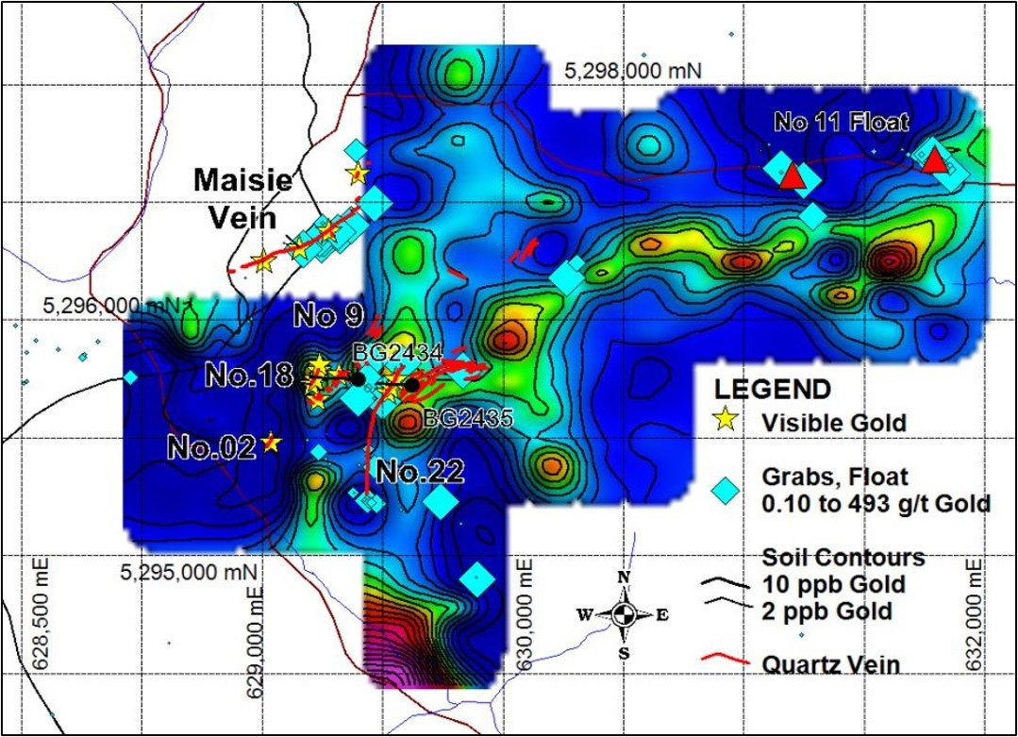
Menneval Gold Project - 5275 Hectares
100% Owned by SLAM Exploration 3 Mineral Claims
Mining-Friendly Jurisdiction
Gold Soil Anomalies 10ppb to 683 ppb
3.000m Strike Length Drill Ready Gold Targets
No 18 vein 3,955 g/t Au over 0.1m
Multiple VG Sites

Slide 16
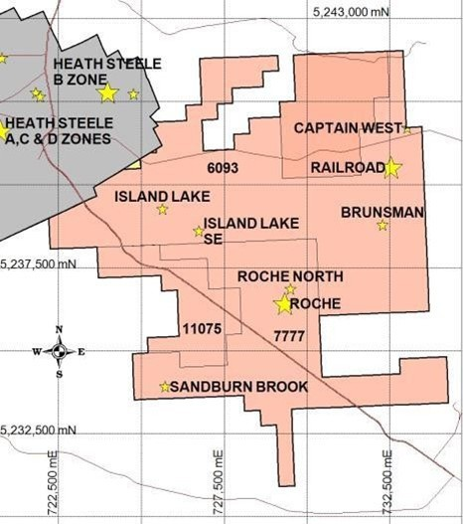
Mine Road Project - 8230 Hectares
Railroad Zone
A 9m core interval grading 14.51% Zn, 5.86% Pb, 139.9 g/t Ag, and 0.67% Cu
Roche Zone
Copper zone open at depth
Hole IL-18-01 with a 7m interval grading 0.9% Cu
Adjacent to Heath Steele Mine 7 VMS Mineral Occurrences

Slide 17
NSR Royalties
SLAM retains royalties and expects share and cash payments on sold or optioned projects
NSR Project | Company Name | Commodity | Canadian Province
Ramsay | Lode Gold Resources Corp. | Gold | New Brunswick
Wedge | Nine Mile Metals Inc. | Copper and Zinc | New Brunswick
Reserve Creek | S2 Minerals Inc. | Gold | Ontario
Opikeigen | S2 Minerals Inc. | Gold | Ontario
Ferguson | Puma Exploration Inc. | Gold | New Brunswick
Nash Creek* | Callinex Mines Inc. | Copper and Zinc | New Brunswick
Superjack* | Callinex Mines Inc. | Copper and Zinc | New Brunswick
*Nash Creek-Superjack agreement is fully vested. SLAM retains NSR royalties on these projects, subject to buyout provisions.

Slide 18
What’s next for SLAM?
August September October
November
December
Goodwin IP
Goodwin Diamond Drilling
Jake Lee Trenching
Menneval Soil Geochem.

Slide 19

TSXV: SXL
US-OTC: SLMXF
Contact
Mike Taylor mike@slamexploration.com 506-623-8960
Jimmy Gravel jimmy@slamexploration.com 902-273-2387
SLAM Exploration Ltd.
295 Hutchinson Drive, Miramichi, New Brunswick Canada E1V 6C7

